Slide 1
RNA-seq analysis
Li Lab
15 June, 2020

Slide 2
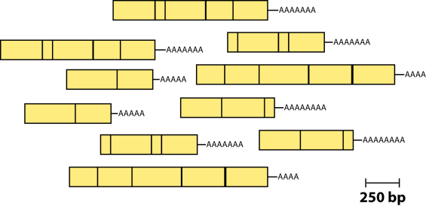
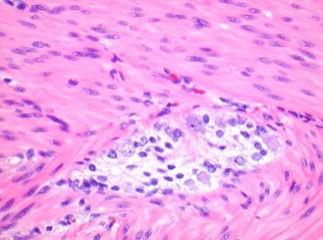
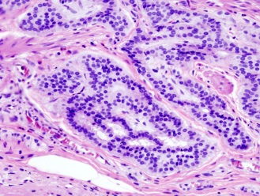
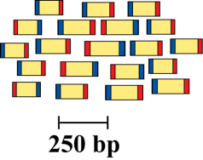
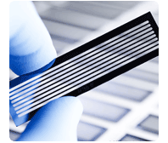
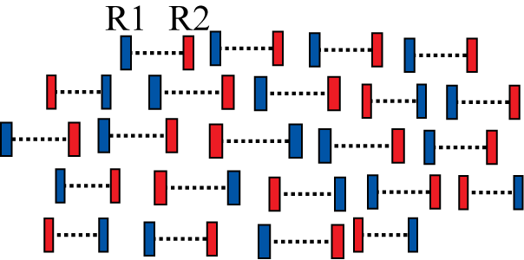
RNA sequencing pipeline
Isolate RNAs
Generate cDNA, fragment, size select, add linkers
Samples of interest
Condition 1
(normal colon)
Condition 2
(colon tumor)
Sequence ends
Map to genome, transcriptome, and predicted exon junctions
100s of millions of paired reads
10s of billions bases of sequence
Downstream analysis

Slide 3
Workflow
1
Raw Sequence Data
FASTQ Files
QC by
FastQC
Reads Mapping
2
Unspliced Mapping
BWA, Bowtie
Spliced mapping
TopHat, Hisat2
Mapped Reads
SAM/BAM Files
Expression Quantification
3
Summarize read counts
featureCounts
FPKM/RPKM
HTseq
viewed by
IGV
DE testing
4
DEseq2, edgeR, etc
Cuffdiff
List of DE
Functional Interpretation
5
Function enrichment
Infer networks
Integrate with other data
Biological Insights & hypothesis

Slide 4
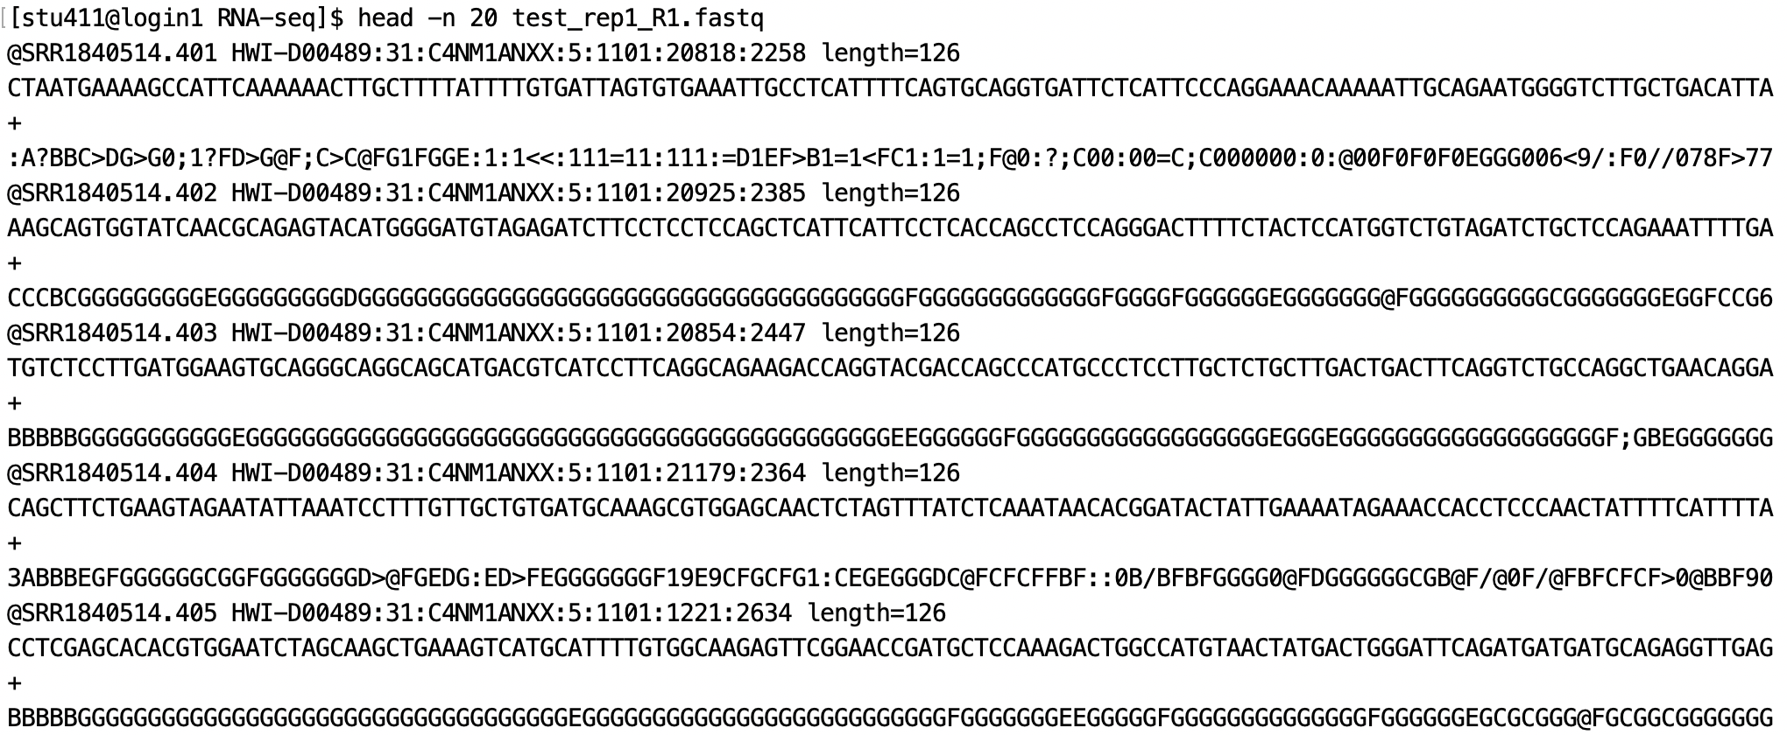
FASTQ files
Line1: Sequence identifier
Line2: Raw sequence
Line3: meaningless
Line4: quality values for the sequence

Slide 5
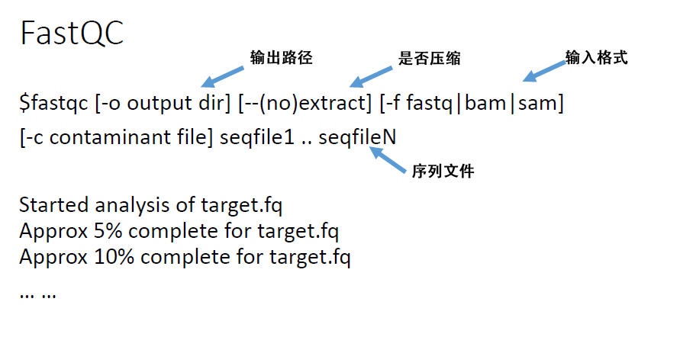
Step 1.
Decide your data is clean data or not?

Slide 6
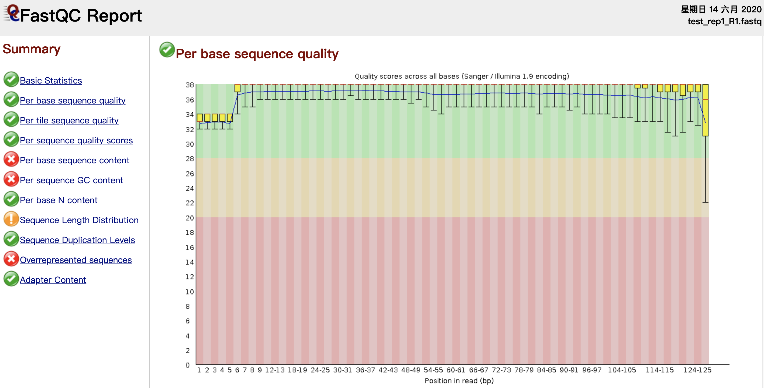
FastQC
Step 1.
Information we need to check
Basic information( total reads, sequence length, etc.)
Per base sequence quality
Adapter Content

Slide 7
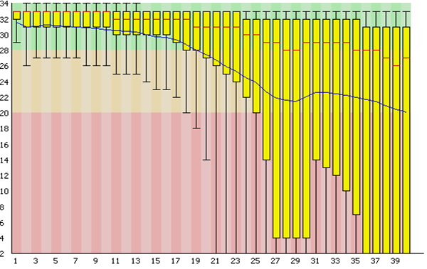
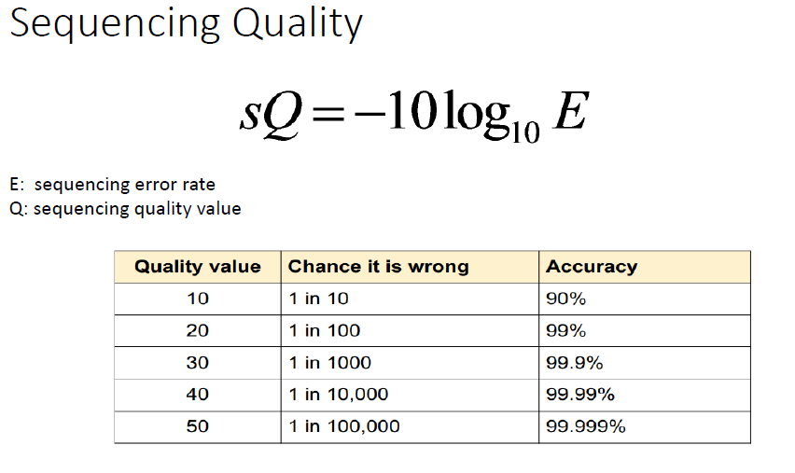
Per base sequence quality
Step 1.
Q > 20 is acceptable

Slide 8
Filtering “dirty” Raw Data
Step 1.
Several steps we need to do:
1. Trimmed adapters in reads.
2. Removed low quality reads.
BBMAP tools:
For Adapters:
bbduk.sh –Xmx1g in=read1.fq in=read2.fq out1=clean1.fq out2=clean2.fq ref=adapters.fq ktrim=r k=23 mink=11 hdisk=1 tpe tbo
For low quality reads:
bbduk.sh –Xmx1g in=read1.fq in=read2.fq out1=clean1.fq out2=clean2.fq qtrim=r trimq=20

Slide 9
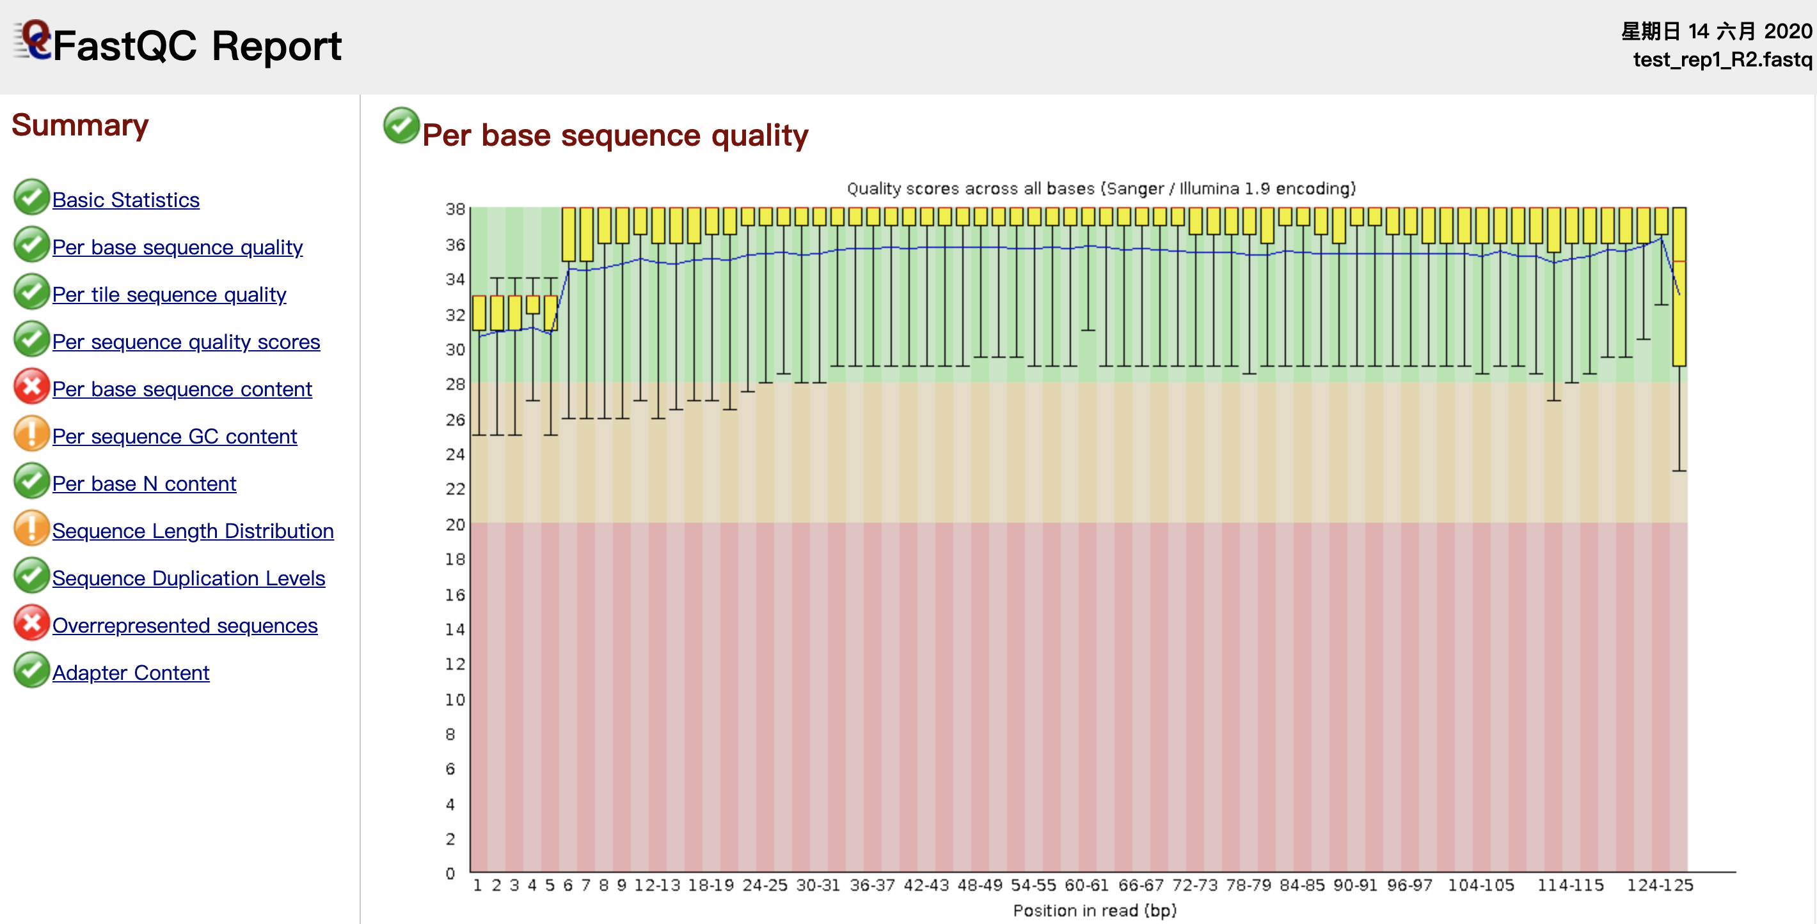
Step 1.
fastqc time0_rep1_R1.fastq
fastqc time0_rep1_R2.fastq

Slide 10
Hisat2/FeatureCounts/DEseq RNA-seq Pipeline
Sequencing
Read alignment
Gene reads counting
Differential expression
RNA-seq reads (2 x 100 bp)
Hisat/Hisat2
alignment (genome)
featureCounts
DESeq2
(A:B comparison)
Raw sequence data
(.fastq files)
Reference genome
(.fa file)
Gene annotation
(.gtf file)
clusterProfiler
Inputs
Function enrichment

Slide 11
Mapping genome
Step 2.
Hisat/Hisat2
Command:
$hisat2 –x <hisat2-idx> {-1 <m1> -2 <m2> } or –U <r> -S <hit>
Parameters:
–x <hisat2-idx> : The basename of the index for the reference genome
{-1 <m1> -2 <m2> } : for pair-end reads
-U <r>: for single reads
-S: sam format output
hisat2 -x /lustre/home/acct-lctest/stu411/RNA-seq/index/mm10/genome -1 time0_rep1_R1.fastq -2 time0_rep1_R2.fastq -S time0_rep1_align.sam
https://ccb.jhu.edu/software/hisat2/index.shtml

Slide 12
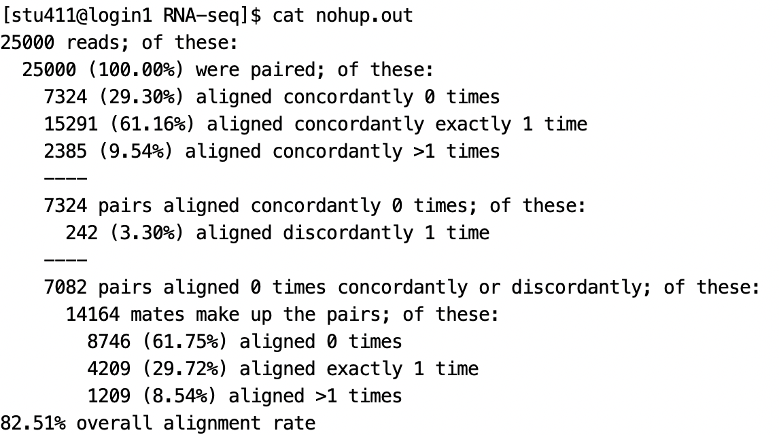
Mapping genome
Step 2.
Hisat/Hisat2
Result:
If the alignment rate is too low, we need take care about the quality of the data

Slide 13
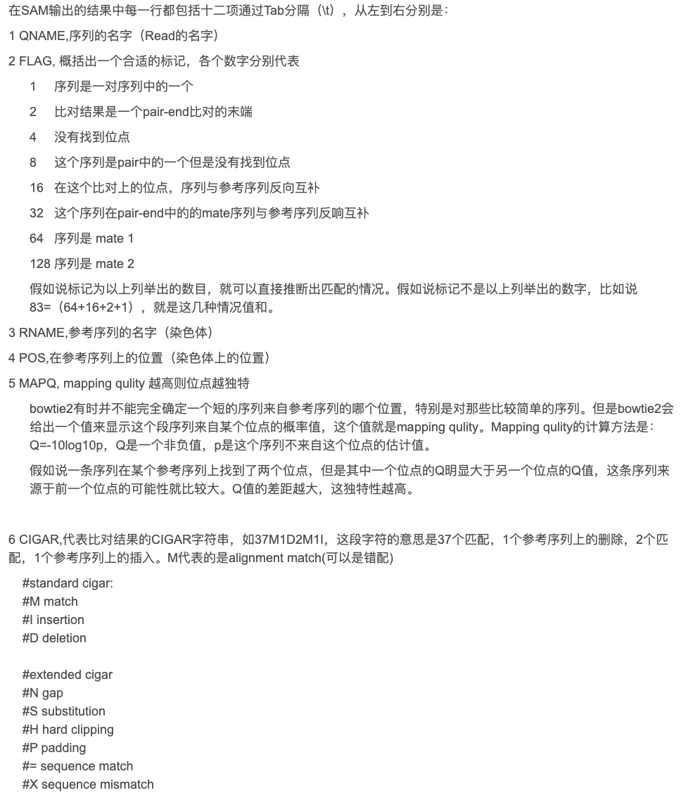
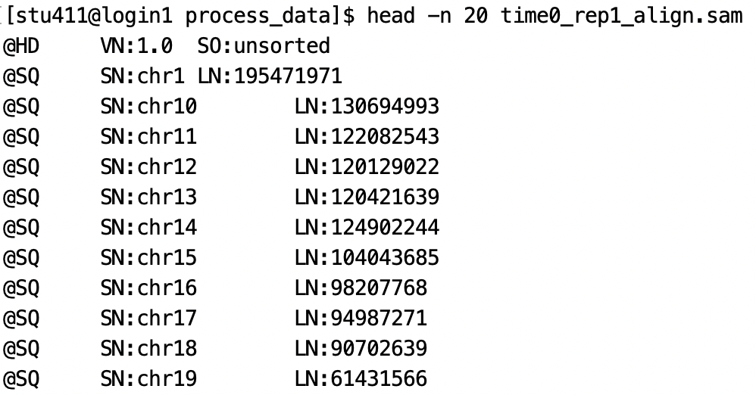
The format of sam
Step 2.
Samtools
Result:
time0_rep1_align.sam
header
Align
Sequence Alignment/Map (SAM) format is a generic format for storing large nucleotide sequence alignments.

Slide 14
Convert sam to bam
Step 2.
Samtools
samtools view -bS time0_rep1_align.sam > time0_rep1_unsorted.bam
samtools sort time0_rep1_unsorted.bam -o time0_rep1_sorted.bam
BAM is the compressed binary version of the Sequence Alignment/Map (SAM) format. It is mainly in order to save space, computer readable.

Slide 15
Gene reads counting
Step 3.
featureCounts
Command:
$ featureCounts -p –a <gtf/gff_files> -o <alignment_files>
Parameters:
–p: If specified, fragments (or templates) will be counted instead of reads. This option is only applicable for paired-end reads; single-end reads are always counted as reads.
-a: Name of an annotation file. GTF/GFF format by default.
-o: Name of output file including read counts. A separate file including summary statistics of counting results is also included in the output ('<string>.summary'). Both files are in tab delimited format.
http://bioinf.wehi.edu.au/featureCounts/

Slide 16
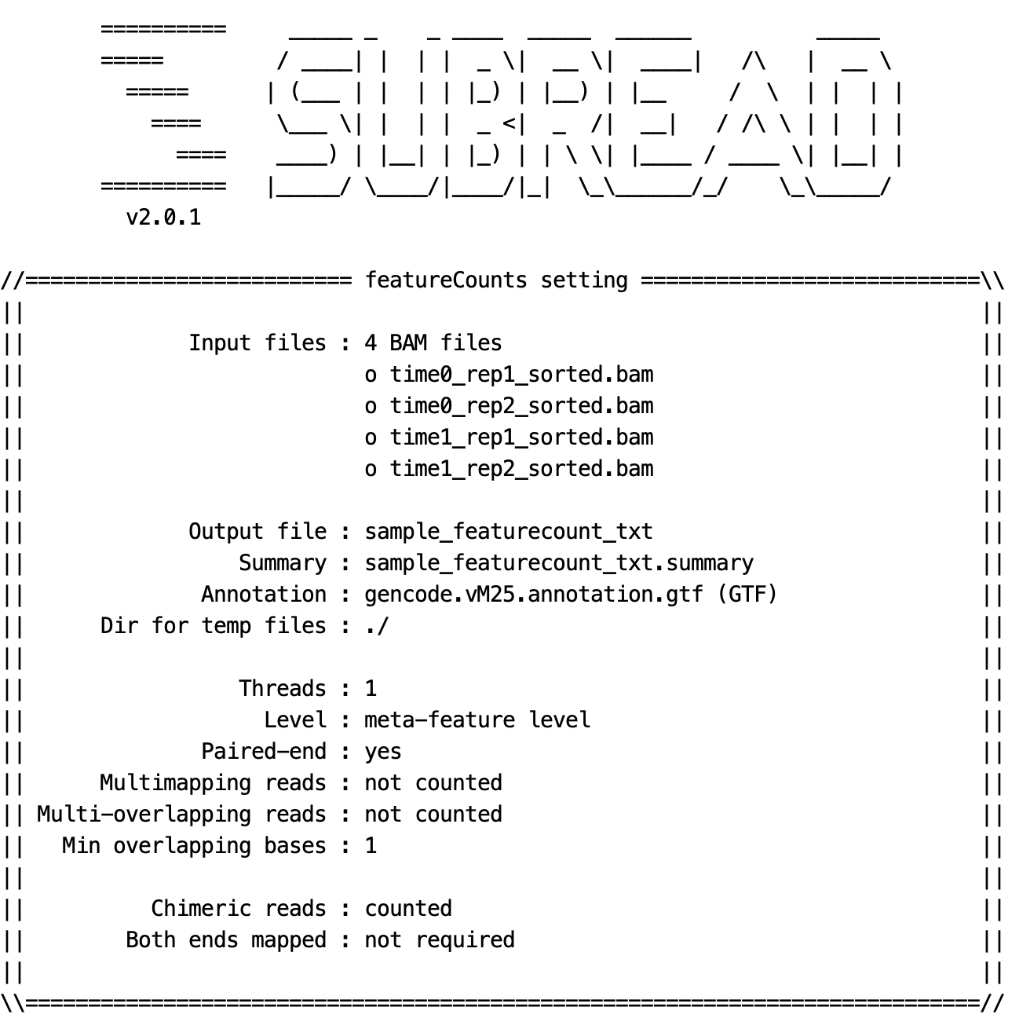
Gene reads counting
Step 3.
featureCounts
One sample
featureCounts -p -a ./annotation/gencode.vM25.annotation.gtf -o test.featurecount_new.txt ./time0_rep1_align.sam
More than one sample
featureCounts -p -a ./annotation/gencode.vM25.annotation.gtf -o sample_featurecount_txt ./time0_rep1_sorted.bam ./time0_rep2_sorted.bam ./time1_rep1_sorted.bam ./time1_rep2_sorted.bam

Slide 17
Gene reads counting
Step 3.
featureCounts
Output
counts

Slide 18
Count-based methods (R packages)
Step 4.
Gene expression
DESeq2-- based on negative binomial distribution
edgeR -- use an overdispersed Poisson model
baySeq -- use an empirical Bayes approach
TSPM -- use a two-stage poisson model

Slide 19
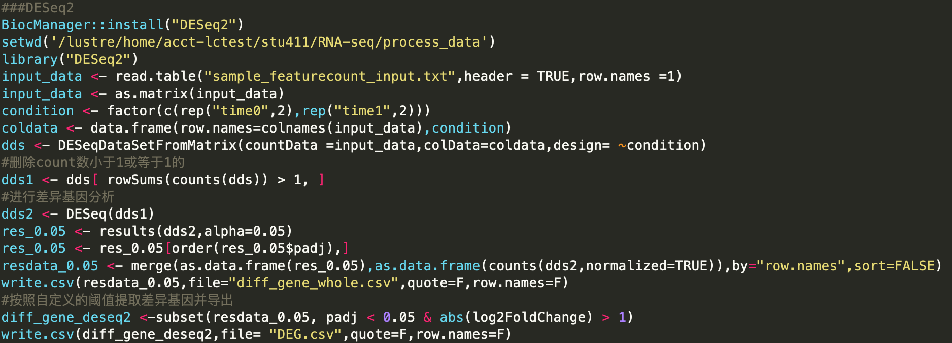
Gene expression
Step 4.
DESeq2
Commands:
https://bioconductor.org/packages/3.7/bioc/vignettes/DESeq2/inst/doc/DESeq2.html

Slide 20
Gene expression
Step 4.
DESeq2
results: DEG.csv
Name | Description
Base mean | The mean of normalized counts for all samples.
IfcSE | The standard error for the Log₂ fold change.
Stat | The Wald statistic for differential expression in two conditions.
padj | Benjamini–Hochberg adjusted P value.

Slide 21
Function enrichment
Step 5.
clusterProfiler
Commands:

Slide 22
Function enrichment
Step 5.
clusterProfiler
results: go.bp.csv
results: KEGG.csv
Name | Description
Gene ratio | The value is obtained by k/n, which n is the size of the list of genes of interest and k is the number of genes within that list which are annotated to the term.
Bg ratio | The value is obtained by M/N, which N is the total number of genes that have annotation in the mouse database, M is the number of genes in the mouse database that are annotated to the terms of interest.
Adjusted P value | Benjamini–Hochberg adjusted P value.

Slide 23
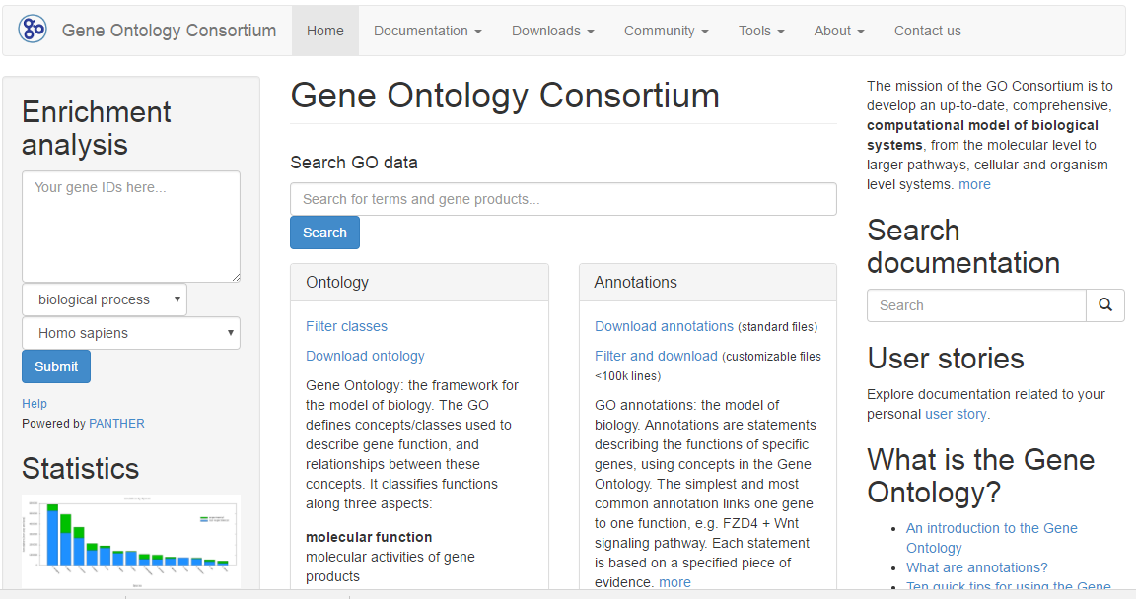
Gene ontology
Step 5.
http://www.geneontology.org/
Input

Slide 24
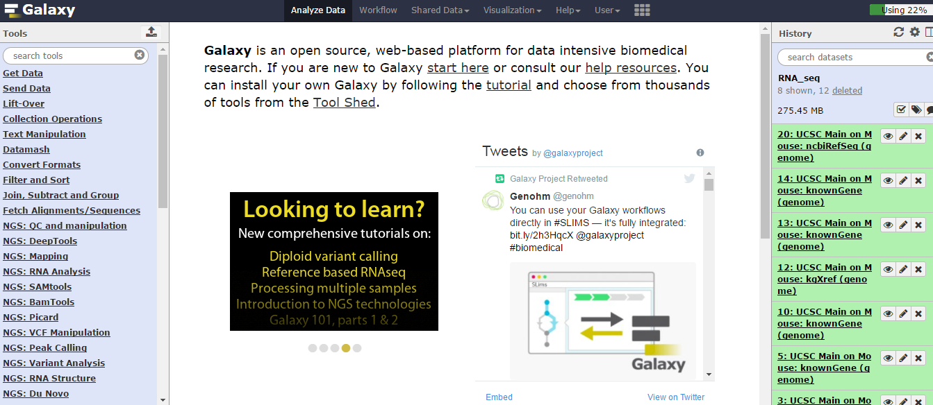
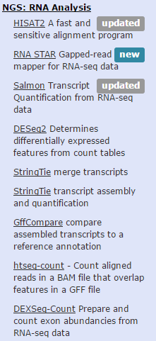
Galaxy platform
Online tool.
https://usegalaxy.org/

Slide 25
References
Garber M, Grabherr MG, Guttman M, Trapnell C. Computational methods for transcriptome annotation and quantification using RNA-seq. Nat Methods. 2011;8(6):469-77.
Oshlack A, Robinson MD, Young MD. From RNA-seq reads to differential expression results. Genome Biol. 2010;11(12):220.
Ozsolak F, Milos PM. RNA sequencing: advances, challenges and opportunities. Nat Rev Genet. 2011;12(2):87-98.
Love MI, Huber W, Anders S. Moderated estimation of fold change and dispersion for RNA-seq data with DESeq2. Genome Biology. 2014 ;15.
Mihaela P etc. Transcript-level expression analysis RNA-seq experiments with HISAT, StringTie and Ballgown. Nat Protocol. 2016;11, 1650-1667.

Slide 26
Thank You
for
Listening

