Slide 1
Topical today
FFT
Reconstruction with magnitude or phase
Practical
The principles of FFT
The implementation of FFT

Slide 2
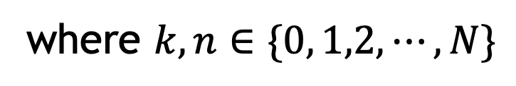
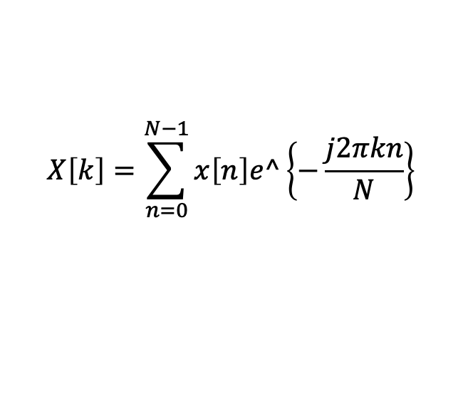
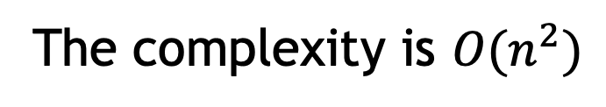
The principles of FFT
DFT
$$X\left[k\right]=\sum_{n=0}^{N−1}{x\left[n\right]e^\left\{−\frac{j2πkn}{N}\right\}}$$
where $k,n∈\{0, 1,2,⋯,N\}$
The complexity is $O(n^{2})$

Slide 3
The principles of FFT
W₈⁶
Symmetry:
W₈⁵
W₈⁷
W_{N}^{k+N/2} = ⁻W_{N}^{k}
W_{N/2}^{k+N/2} = W_{N/2}^{k}
W₈⁴
W₈⁰ = W₈⁸
W₈^{k+4} = ⁻W₈^{k}
Periodicity:
W₈^{k+8} = W₈^{k}
W₈³
W₈¹ = W₈⁹
W₈²

Slide 4
The principles of FFT
The DFT can be rewritten as:
Since:
Then:
(1)
(2)

Slide 5

The principles of FFT
Combine the property of $W_{N}^{k}$,we have:
(3)
(4)

Slide 6
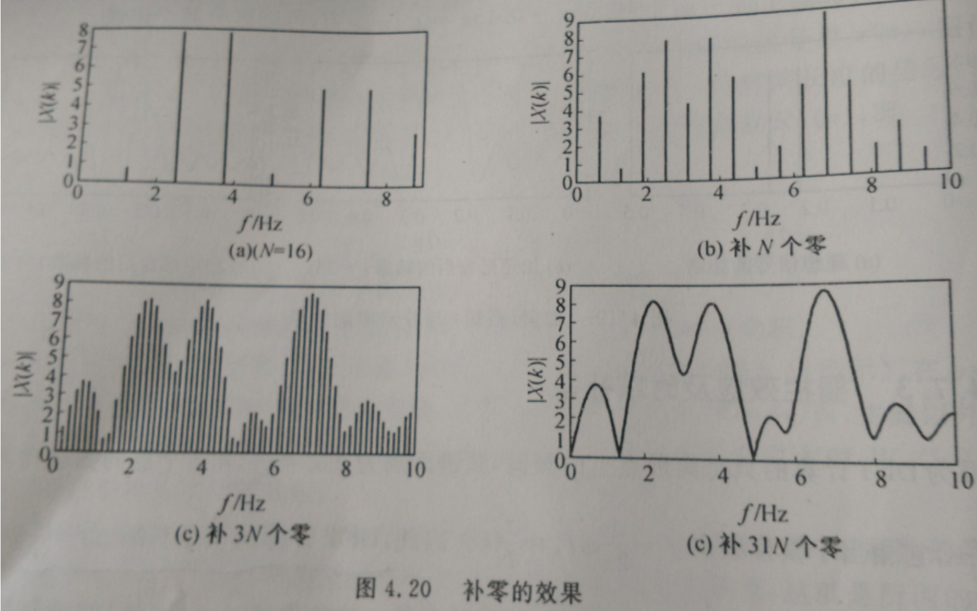
The principles of FFT

